Slide 1


Probability Distribution
Md. Ahsan Ullah
Lecturer, Department of CSE
University of Liberal Arts Bangladesh
10-08-25
Department of CSE, ULAB

Slide 2



Slide 3
Probability distribution:
In Statistics, the probability distribution gives the possibility of each outcome of a random experiment or event. It provides the probabilities of different possible occurrences.
Discrete Probability Distribution:
A probability distribution is discrete when the random variable takes a finite or countably infinite number of distinct values. Examples: Number of heads in coin tosses, number of students in a class, rolling a die.
Continuous Probability Distribution:
A probability distribution is continuous when the random variable can take any value within an interval (infinitely many possibilities that cannot be listed). Examples: Height of students, time taken to finish a race, temperature.

Slide 4
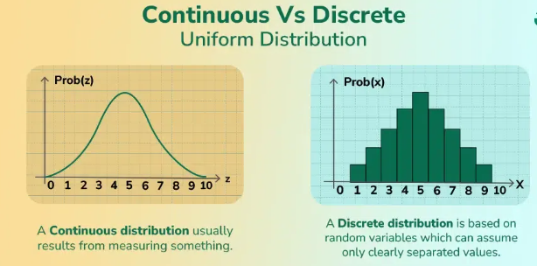

Slide 5
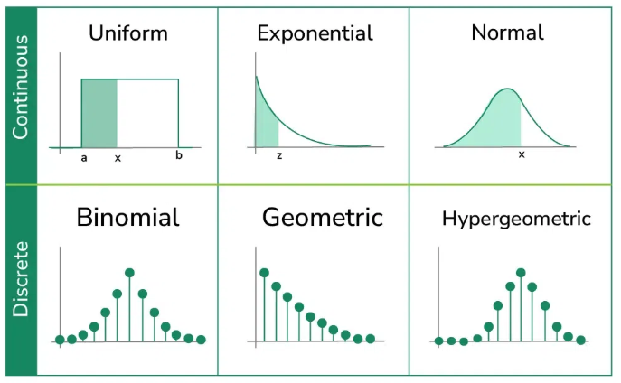

Slide 6

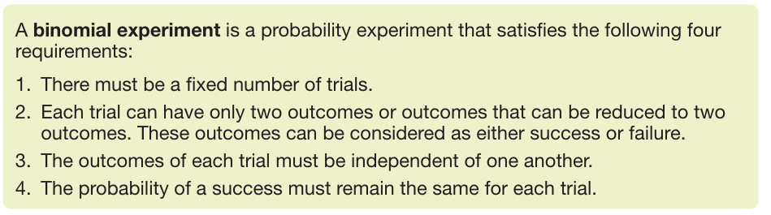
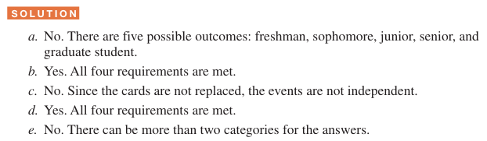
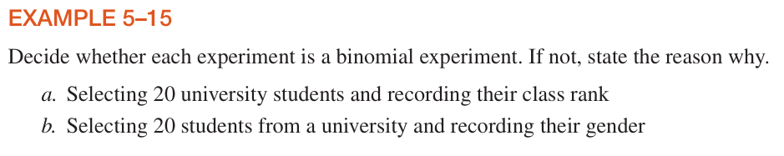
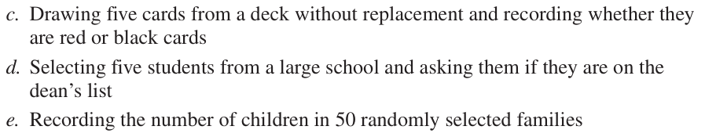
(Discrete)

Slide 7
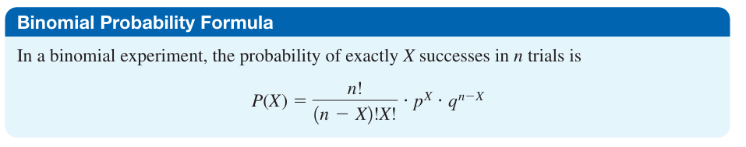


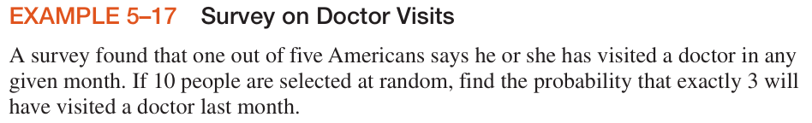
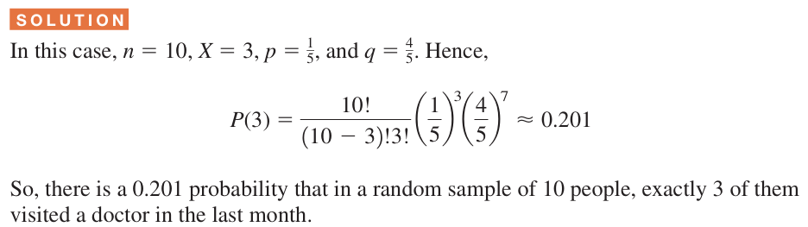

Slide 8
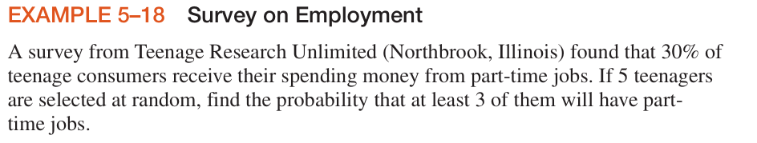
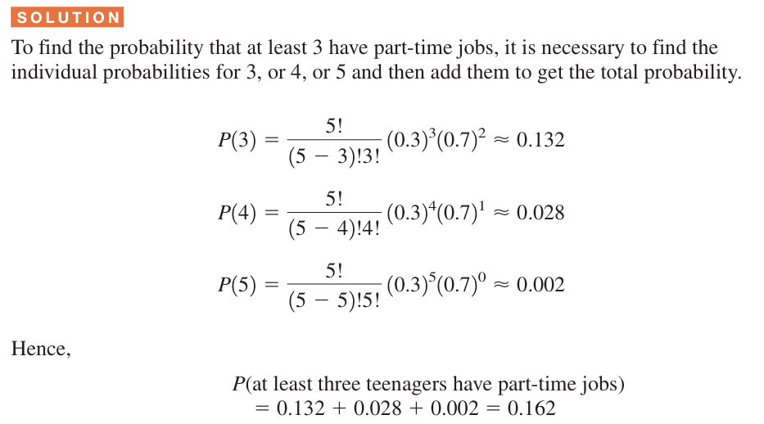

Slide 9
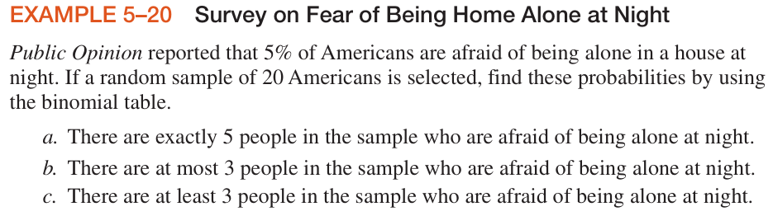
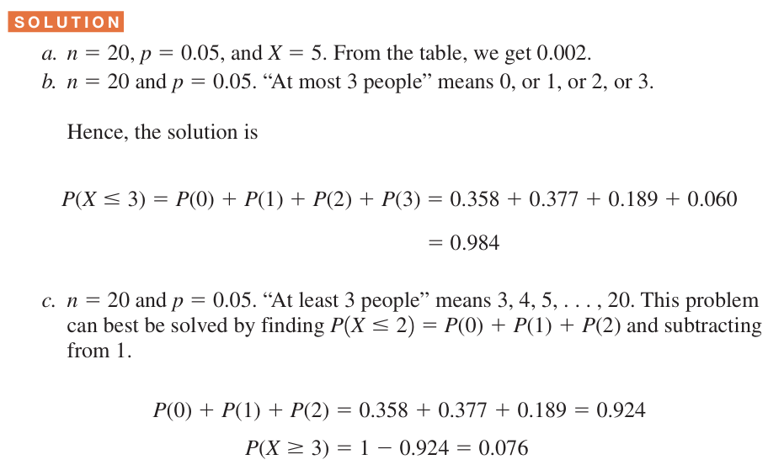

Slide 10
